Slide 1

SCHOOL DISCIPLINE: What parents need to know Guest: Barrie lynn tapia, special education attorney
SCHOOL DISCIPLINE: What parents need to know
Advocates for Justice and Education, Inc.
The Parent Training and Information Center for the District of Columbia
Notes:
Our passion is empowering families by equipping parents and students with disabilities with the tools they need to be their own advocates.
AJE’s mission is to empower families, youth, and the community to be effective advocates to ensure that children and youth, particularly those who have special needs, receive access to appropriate education and health services.

Slide 2
Join the webinar at: https://join.Me/ajeparents or join via conference call: +1.202.602.1295 access code:399-428-506# questions? Email information@aje-dc.Org AJE Special Education Thursdays: offering a better understanding of DC special education in a "bite-size" format These 30-minute sessions, available online, give parents and professionals: information, education and a better understanding of DC special education issues in a "bite-size" format. Special Education Thursdays are provided FREE for parents and professionals to answer your questions about special education in DC, where to go for help, and to learn how to advocate for a child with a disability or learning need.
Advocates for Justice and Education, Inc.
The Parent Training and Information Center for the District of Columbia
Notes:
Our passion is empowering families by equipping parents and students with disabilities with the tools they need to be their own advocates.
AJE’s mission is to empower families, youth, and the community to be effective advocates to ensure that children and youth, particularly those who have special needs, receive access to appropriate education and health services.

Slide 3


What is SFASA??
DC Council On July 12, 2018, the District of Columbia passed the Student Fair Access to School Amendment Act of 2018 (SFASA).
What does the new law do??
SFSA requires changes to how ALL schools handle
discipline over the next 3 years.* Charter DCPS
Sets limits on schools’ use of suspensions, expulsions, and involuntary transfers* as disciplinary consequences.
Provides additional rights for parents and students in all public schools.
Notes:
Law went into effect on August 25, 2018. Some changes effective immediately. Others phased in at later dates. Others will go into effect if funding available.
*For Involuntary transfer - DCPS has to justify - can’t be as a disciplinary response. Not a valid disciplinary response.

Slide 4

on Out of School Suspensions SY 2018-2019
Out-of-School Suspension for an any one incident limited to 5 consecutive days in grades K – 5.
Out-of-School Suspension for any one incident limited to 10 consecutive days in grades 6 – 12.
All grades (K-12) there is a cap of 20 days of Out-of-School Suspension in total UNLESS the head of the local education agency (LEA) provides “a written justification to the student and parent describing why exceeding the 20-day limit is a more appropriate disciplinary action than alternative responses.”
5 - 10 - 20
Notes:
Per incident. Cumulative - 20.

Slide 5


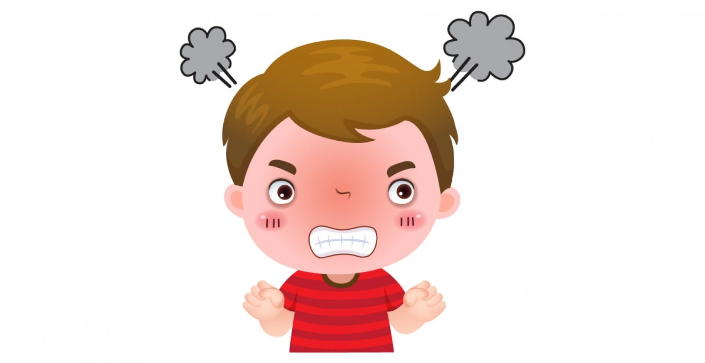

School Year 2019-2020
Grades K-8
NO out of school suspensions, expulsions and involuntary transfers unless student’s behavior poses a safety or emotional distress concern.
Willfully caused, attempted to cause, or threatened to cause bodily injury or emotional stress to another person, including behavior that happens off school grounds (that impacts school community).
Notes:
Emotional distress - mental suffering or distress that requires more than trivial treatment or counseling.
Administrator must determine whether behavior meets this definition consistent with school policy.
Must be a nexus between behavior and school - jurisdiction

Slide 6




School Year 2020-2021
Grades 9-12
Out of school suspensions, expulsions and involuntary transfers cannot be used for:
Any dress code violation
Willful defiance
Any incident occurring off school grounds that is not part of a school
sponsored activity (unless the student’s behavior poses a safety or
emotional distress concern).
Notes:
Willful Defiance - Disrupting school activities or intentionally defying the valid authority of school staff
(Research has shown that students of color are seen as insubordinate, defiant or disrespectful in situations where their white peers are not seen that way for the same behaviors)
Exception: students over age 18 at a school where more than ½ students are over 18

Slide 7

Student Rights Under SFASA
Students are entitled to a hearing for
any suspension six (6) days or longer.
Students CANNOT BE REMOVED from school prior to the hearing UNLESS…
The student’s conduct “necessitated emergency removal” and the head of the LEA provides written justification to the student and parent.
**DANGER == EMERGENCY REMOVAL**
Notes:
Before entitled to hearing if 10 days or more - now 6. Six days considered long term suspension.
Hearing before an impartial hearing officer - DC Office of Administrative Hearings (OAH). Parent has right to appeal any suspension. Request orally or in writing.
Student may be removed immediately prior to all aspects of due process being completed if they are contributing to an emergency situation in the school.
Gen Ed - must prove student creates a serious threat to the school community.
DCPS requires that the Chancellor provide the written justification.- must prove student creates a serious threat to the school community.
Exception: If a student violates the Gun Free Schools Act (requires school to expel a student who brings a firearm to, or possesses a firearm at school for a period of not less than one year.

Slide 8

Advocates for Justice and Education The federally designated Parent Training & Information Center for Washington D.C. Educate. Advocate. Empower.
AJE’s mission is to empower families, youth, and the community to be effective advocates to ensure that children and youth, particularly those who have special needs, receive access to appropriate education and health services.
Our passion is empowering families by equipping parents and students with disabilities with the tools they need to be their own advocates.
1200 G Street, NW #725 (new address!)
Washington, DC 20005
Hours: Monday-Friday, 9:00am-5:00pm
Phone: (202) 678-8060
www.aje-dc.org
information@aje-dc.org
@AJEinc
Mary’s Center Location
3912 Georgia Ave. NW
Washington, DC 20011
Hours: Tuesday & Thursday
9:00am-5:00pm

